Slide 2
Flight Controller for Autonomous Drones
Student: Supervisor(s):
Marcus Christiansen Søren Hansen
Nils Axel Andersen

Slide 3
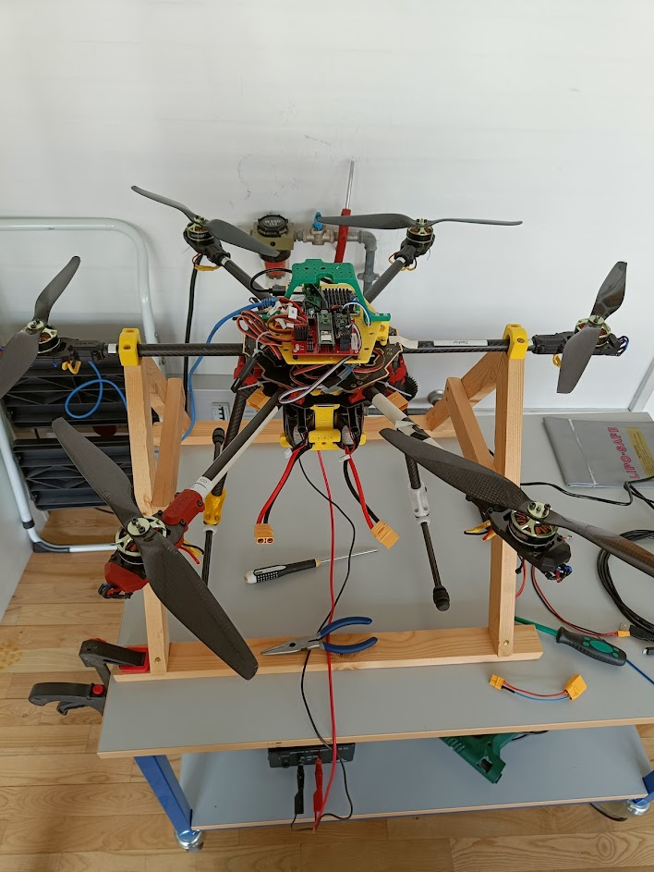
Task
Get this to fly

Slide 4
Task
Known issues:
Unscheduled landing
Communication between teensy and Pi
Objectives:
Position & Velocity Control via OptiTrack
First in simulation
Next on the actual drone
Position & Velocity Control via Aruco
Camera based positioning

Slide 5
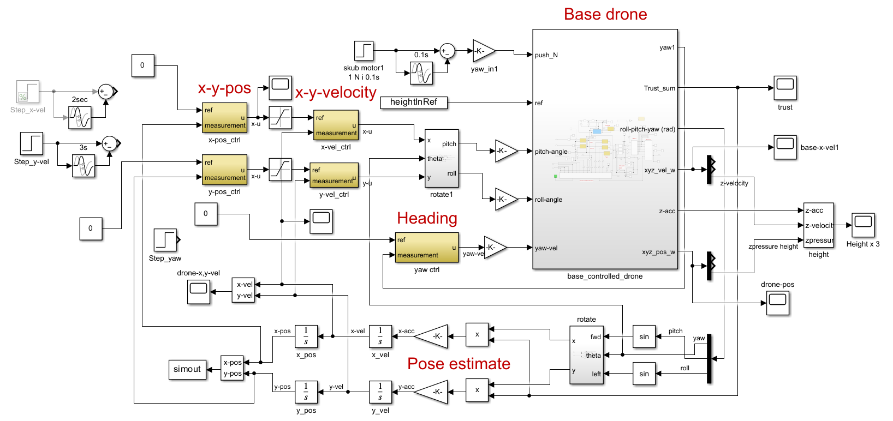
Simulation

